Slide 1
Micro-ROS Communication
Quality of Service
(QoS)

Slide 2
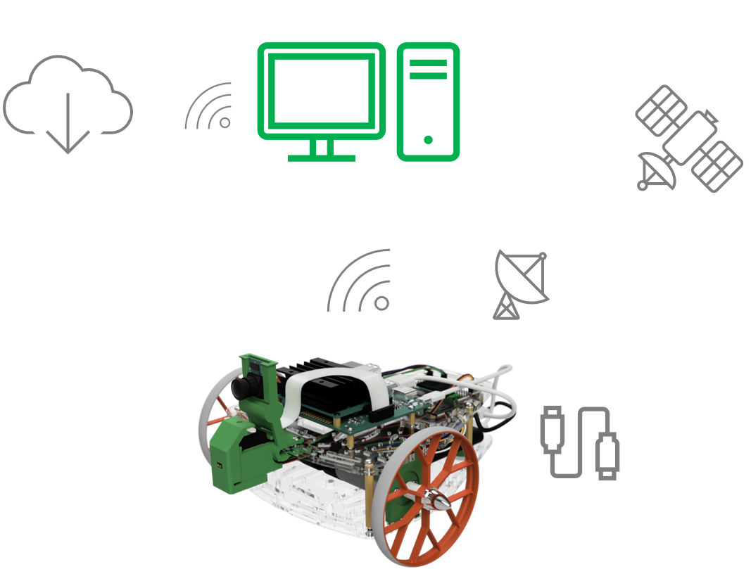
Introduction
Challenges in Robotic Communication
Mobile robots typically rely on Wi-Fi or other wireless networks, where bandwidth and latency can fluctuate based on the communication protocol.
Signal strength and network stability can vary unpredictably due to the robot’s movement and its distance from the user.
Not all robot operations require the same level of reliability—some tasks demand real-time, guaranteed communication, while others can tolerate occasional data loss.

Slide 3
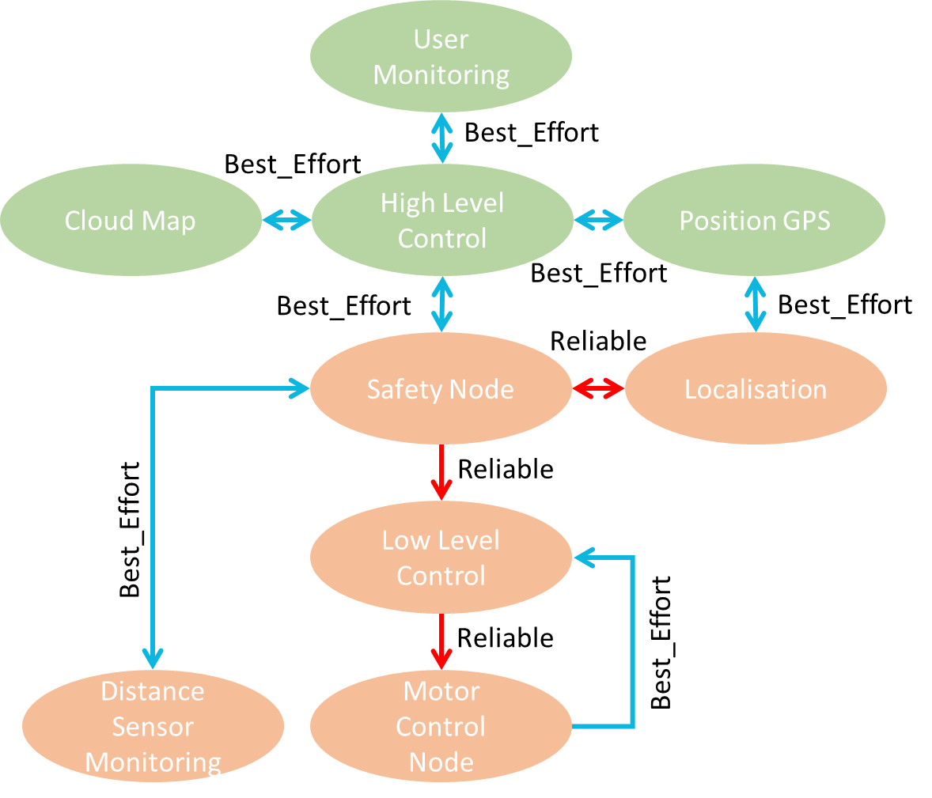
Introduction
Simple Example
A teleoperated mobile robot: Reliable QoS (e.g., motor commands)
The robot must always receive movement commands.
Uses Reliable QoS to ensure commands are delivered.
Best-Effort QoS (e.g., laser sensor streaming)
The robot sends a laser sensor information to a node.
Uses Best-Effort QoS because occasional frame drops don’t affect the robot’s operation; also, you prefer the latest data.
It is preferable to have the latest information from the laser sensor.

Slide 4
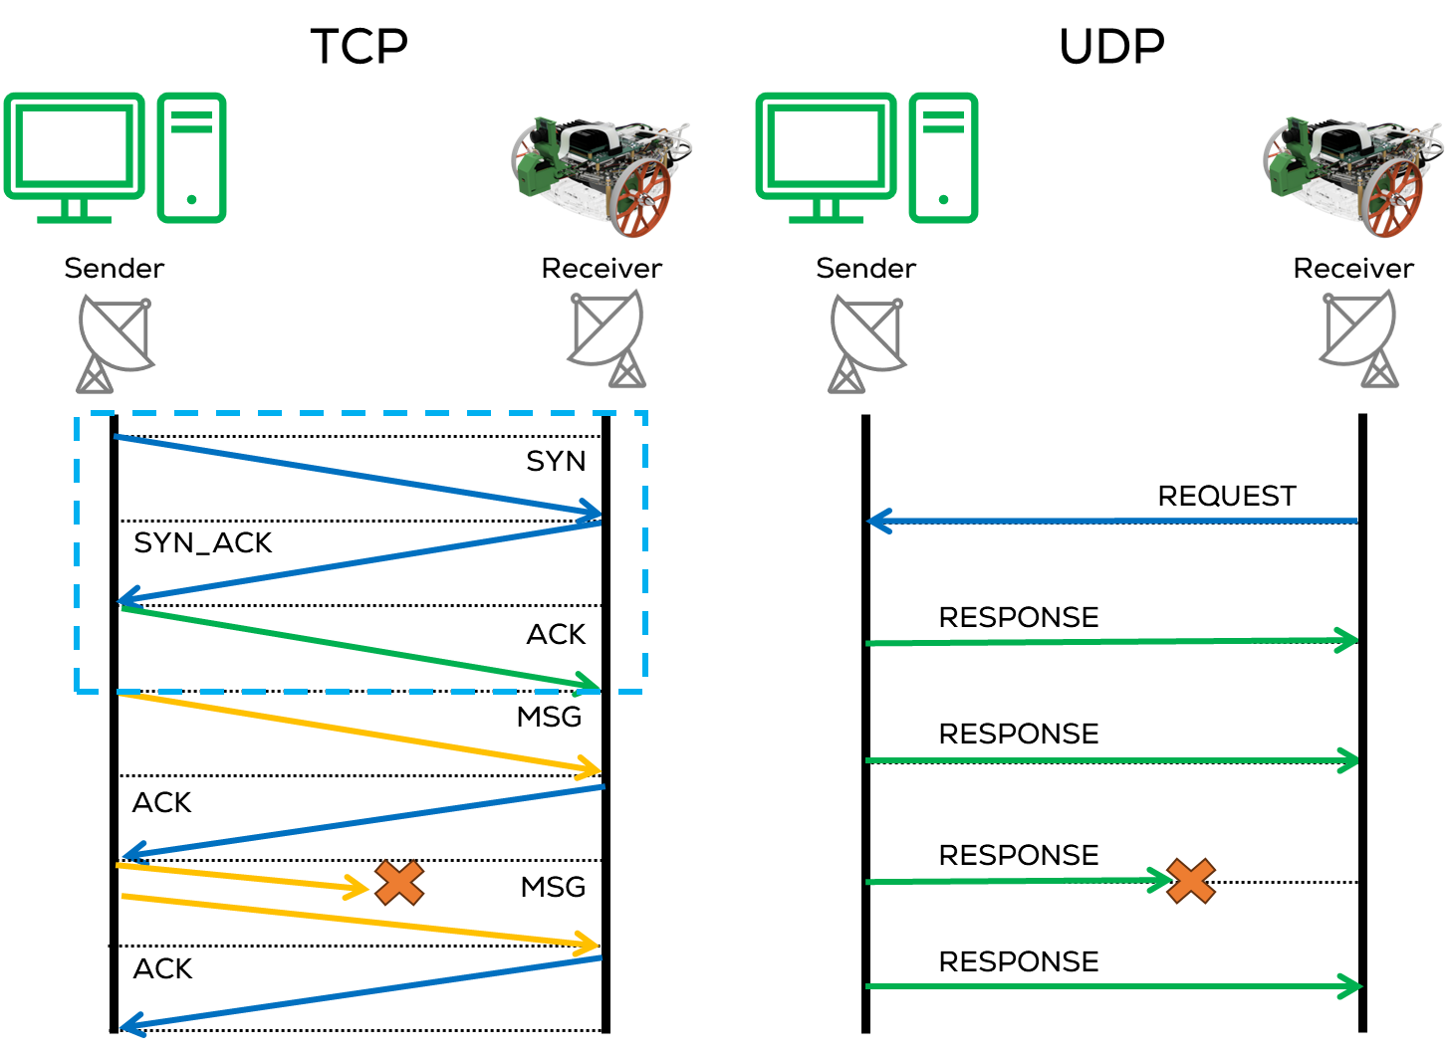
Quality of Service (QoS)
Quality of Service
QoS lets us express these performance priorities to the underlying communication system.
QoS (Quality of Service) are a set of policies that define how data is transmitted and managed between nodes.
QoS policies control message delivery behaviour in a ROS 2 network and determine how messages are handled, including reliability, durability, and history.
“ROS 2 communication can be as reliable as TCP or as best-effort as UDP.”
QoS policies help optimize communication for real-time robotics applications

Slide 5
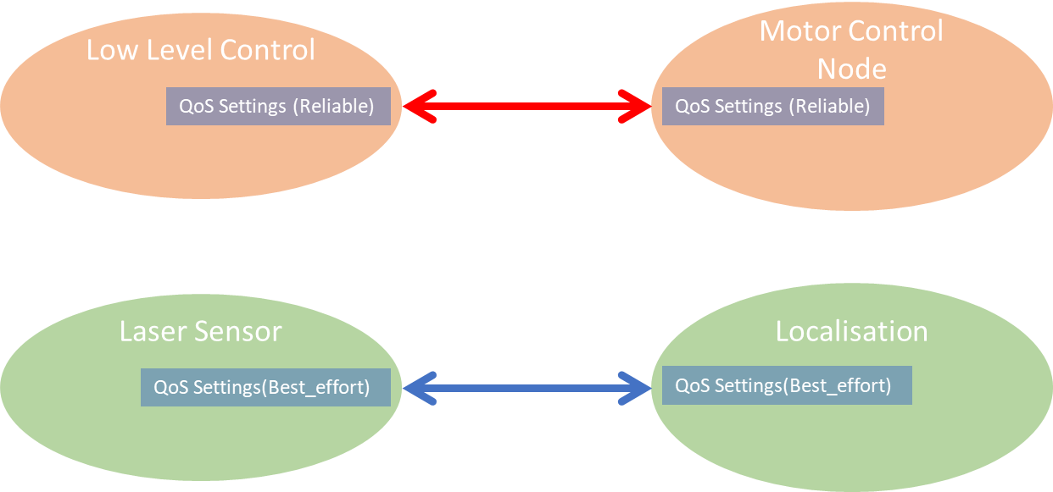
Quality of Service (QoS)
Quality of Service
QoS policies modify communication for publishers, subscribers, and services.
QoS Policies allow:
Reliable (TCP) connections for mission-critical robot operations.
Best-effort (UDP) connections for debugging & non-critical monitoring. Preference for the latest data quickly rather than reliable data.
A set of QoS “policies” combine to form a QoS “profile”.

Slide 6
Quality of Service (QoS)
Key QoS Policies
History: How middleware handles buffering messages waiting to be sent to the network or passed to a callback function.
Keep Last: Stores a fixed number of recent messages, configurable via the queue [depth] option (default is 10).
Keep All: Stores all messages until processed (subject to the configured resource limits of the underlying middleware).
Depth: Size of the message queue, honoured if the “History” policy was set to “keep last”. (e.g., 10 messages).
Reliability: Ensures the middleware that each message is delivered to the receiver.
Reliable: Guarantees message delivery, suitable for critical data, may retry multiple times.
Best Effort: Delivers messages as best as possible; may lose them if the network is not robust. Suitable for non-critical data.
Durability: New subscribers get the latest message or wait until the next published message.
Volatile: Messages are not stored; only current subscribers receive messages.
Transient Local: Stores/Sends messages for late-joining subscribers.

Slide 7
Quality of Service (QoS)
QoS
More QoS policies, such as Deadline, Lifespan, Liveliness, and Lease Duration, are available; more information is here.
Setting individual setting values for each publisher/subscriber/service can be tedious and inefficient.
Profiles are used to integrate a set of policies that can be implemented for different tasks.
ROS and micro-ros include some predefined QoS profiles that apply to most applications; ROS2 allows the user to reconfigure (tune) them if necessary.
The user can implement its own QoS Profile and Policies using the QoS class.
Standard ROS included QoS Profiles:
System Defaults Profile
Sensor Data Profile:

Slide 8
Quality of Service (QoS)
QoS Profiles
System Defaults Profile (rmw_qos_profile_default):
Uses all the system default values as defined by the middleware implementation currently being used.
History: “keep last”
Depth: 10
Reliability: “reliable”
Durabiltiy: “volatile”
Liveliness, deadline, lifespan, and lease durations = “default”.
static const rmw_qos_profile_t rmw_qos_profile_default =
{
RMW_QOS_POLICY_HISTORY_KEEP_LAST,
10,
RMW_QOS_POLICY_RELIABILITY_RELIABLE,
RMW_QOS_POLICY_DURABILITY_VOLATILE,
RMW_QOS_DEADLINE_DEFAULT,
RMW_QOS_LIFESPAN_DEFAULT,
RMW_QOS_POLICY_LIVELINESS_SYSTEM_DEFAULT,
RMW_QOS_LIVELINESS_LEASE_DURATION_DEFAULT,
false
};

Slide 9
Quality of Service (QoS)
static const rmw_qos_profile_t rmw_qos_profile_sensor_data =
{
RMW_QOS_POLICY_HISTORY_KEEP_LAST,
5,
RMW_QOS_POLICY_RELIABILITY_BEST_EFFORT,
RMW_QOS_POLICY_DURABILITY_VOLATILE,
RMW_QOS_DEADLINE_DEFAULT,
RMW_QOS_LIFESPAN_DEFAULT,
RMW_QOS_POLICY_LIVELINESS_SYSTEM_DEFAULT,
RMW_QOS_LIVELINESS_LEASE_DURATION_DEFAULT,
false
};
Sensor Data Profile (rmw_qos_profile_sensor_data):
Getting the latest data quickly, even if it misses some data.
History: “keep last”
Depth: 5
Reliability: “best_effort”
Durabiltiy: “volatile”
Liveliness, deadline, lifespan, and lease durations = “default”.

Slide 10
Quality of Service (QoS)
QoS Profiles
QoS Setting needs to be agreed upon by the publisher and the subscriber.
Some combinations of settings are compatible, and others are incompatible.
ROS Provides some tables here, to verify the compatibility between policies.
The user must check the compatibility of these QoS Profiles. One incompatible setting will prevent the connection entirely.
Publisher | Subscription | Compatible
Best effort | Best effort | Yes
Best effort | Reliable | No
Reliable | Best effort | Yes
Reliable | Reliable | Yes
Publisher | Subscription | Compatible | Result
Volatile | Volatile | Yes | New messages only
Volatile | Transient local | No | No communication
Transient local | Volatile | Yes | New messages only
Transient local | Transient local | Yes | New and old messages

Slide 11
Micro-ROS Serial Communication
Activity 1: QoS Publisher + Subscriber

